Slide 1
SMART WATER SYSTEM

Slide 2
PROBLEM DEFINITION
Implementing IoT sensors to monitor water consumption in public places such as parks and gardens.
Objective :
To promote water conservation by making real-time water consumption data publicly available.
To get better understanding of the daily cycles of water demand
To produce more resilient and effective water supply system, reducing cost and improving sustainability

Slide 3
IOT SENSORS REQUIRED
FLOW SENSOR - helps in detecting leaks and monitoring water consumption
WATER PRESSURE SENSOR - to detect abnormal pressure drops
WATER LEAK SENSORS - to detect presence of water and send alerts to prevent water damage
WATER QUALITY SENSORS - to measure parameters like pH, turbidity, temperature and presence of contaminants

Slide 4
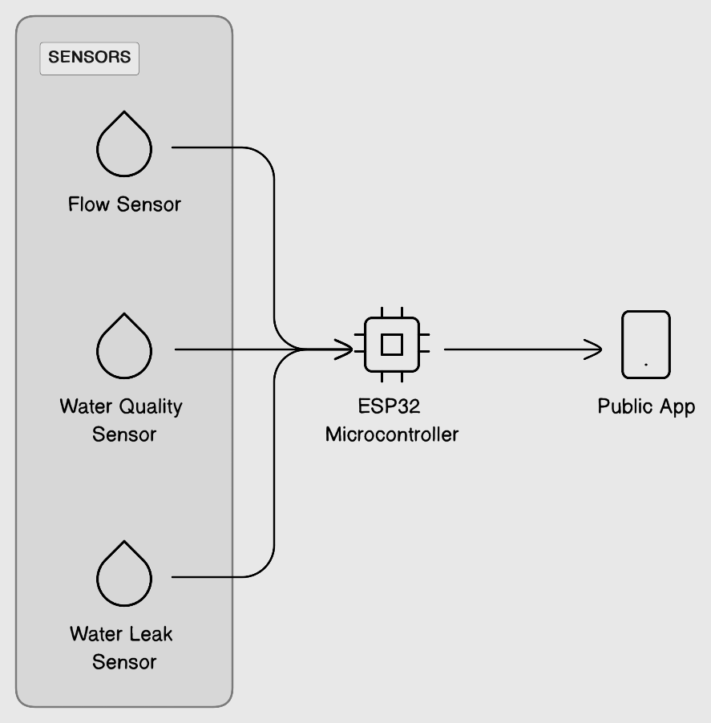
IOT DESIGN THINKING

Slide 5
REAL TIME TRANSIT INFORMATION PLATFORM
ESP32 FIRMWARE - to read sensor data at regular intervals
WiFi Connectivity - configure ESP32 to connect to your local WiFi network
Data Collection - Collect data from sensors and store it in variables
Data Transmission - Transmit the data to cloud server or local server using HTTP
App Development - to visalise collected data
Real Time updates - to provide users with live information about water consumption and quality
Notifications - to alert users incase of water leaks or poor water quality

Slide 6
Integration Approach
Water Flow Sensor, Water leak Sensor and Water quality sensors are connected to ESP32 Microcontroller, where these sensors typically have a digital output that can be read by ESP32
ESP32 provides WiFi capabilities where the collected data can be transmitted to the cloud sever or local server
With the help of an App these saved datas can be collected in regular intervals to monitor the water consumption, water leaks and water quality in real time to Conserve Water for Sustainability

